Slide 1
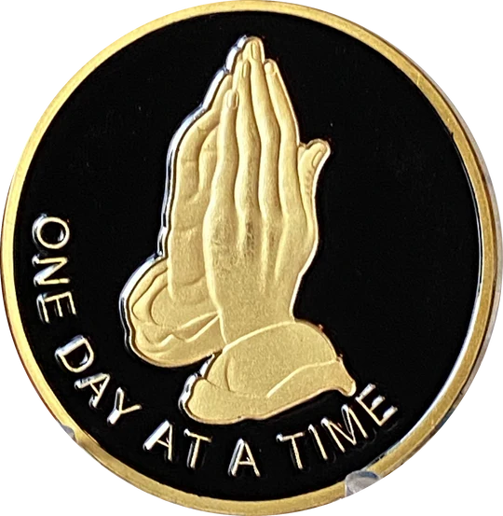
Minister Martin Jones
October 8-9, 2024
How do we handle Addictive Behaviors?

Slide 2
You know family, if we are honest, we all have behaviors, rather small or big, that we need to get behind us. We can be overwhelmed and pressed on every side trying to get through the other side of our addictive behaviors. They can either not be obvious or on blast – right? Sometimes releasing these behaviors can make us feel as if we are loosing a part of ourselves. We can be like a Prisoner of War (POW) within our behaviors.
They have a grip or hold on us that we cannot shake. This is real family. We have all been there and maybe we are there right now – Amen. We can get the case of the “I just can’t help it.”
These behaviors bring us down but we feel trapped sometimes if we go without that behavior. This is very serious because in the midst, we cannot sometimes see how to be set free from this thing.
Note, here we are not talking about chemical addiction; that is a different animal. We are talking about our behavioral addictions that are going to require us to shift our focus. It’s going to require us to give up our flesh and mind and turn it over to the Holy Spirit. WOW, how difficult is that? This can be extremely hard in the grip of a behavioral addiction…..

Slide 3
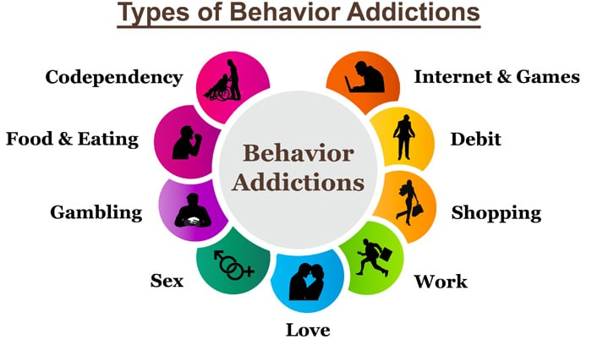
This is not by far a total list, but here are some major ones…

Slide 4
Be encouraged!!! - GOD does not want us in vicious cycles of ungodliness and being unproductive. What did the Holy Spirit say to the people thru Jeremiah? Chapter 2 :11-14. Sometimes our addictive behaviors may seem to put us in exile????
Notice the action words here – After being driven into exile, GOD gives them some encouragement that we can build from ourselves. We have to be diligent in seeking Him.
V12 – Call , Pray
V13 – Seek and Search for Him with all your heart..
*Seek – Hebrew word – (baw – kash’) to search out in worship and prayer *Search – Hebrew word – (daw – rash ) – to tread or frequent … to follow for pursuit
Each one of the action words He promises to react to.
V12 – I will hearken unto you- Hearken – Hebrew word –(sha-mah) to hear intelligently.
V13 - You will find him.

Slide 5
Sometimes we lean on Psychologist, Psychiatrist , counselors, etc. These professionals are really good and can help, but make sure you pray for the right one, Amen. Sad to say all these folks don’t have our best interest in mind, so let the Holy Spirit lead you to the correct one. Sometimes accountability partners are good to keep us on track. We need someone that is going to keep it real. The kind of person who can tell us the real truth about ourselves and we can still be friends – Oh boy!!!!!!
All of these can be great avenues to help us, but until our mind is right, nothing will happen.
Often times these behaviors are anchored in our worldliness.
We need to transition to a new way of thinking…… Amen
Let’s look at some of the steps and scriptures that can help us with our addictive behaviors. These behaviors can be anything that is ungodly or nonproductive that we cannot shake – Amen. No matter how hard you try, you cannot seem to move past it permanently.
1. You must admit it - right. Admitting that there is a problem sometimes is the biggest step. It will be revealed anyway ………Luke 8:17 , Hebrews 4:13.

Slide 6
You must admit it - right.(con’t) Denying there is an issue is a deterrent to ridding ourselves of it. This admission has to be within self to GOD and remember (1st John 1:9 ).
Also an admission to others (the right person) can often times take a lift off our shoulders to help us move forward. Sometimes when we admit to others it can bring some transparency to a situation and help.
2. Pray , Pray , Pray for GOD’s revelation and intervention
What are we saying here?
Sometimes these behaviors may be teaching us about who we are and GOD wants us to learn something about who HE is. Instead of this behavior fleeing from us and that is it, what can I learn from this? John 16:33, 2nd Corinthians 12:9
When praying :
Hebrews 4:14-16 –He has experienced everything yet without sin
Proverbs 15:8 – Be upright
Romans 8:26-27 – The HOLY SPIRIT can interpret for us
Psalms 145:18 – He will draw nigh - Hebrew word – (qarab) –bring near for purpose
Psalms 27:14 – Be patient

Slide 7
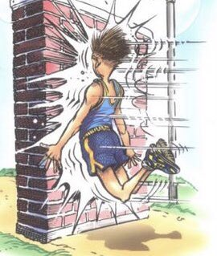
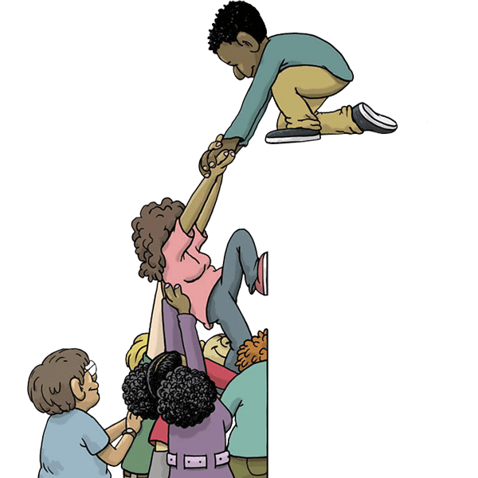
3. Don’t think you know how to solve it - Don’t get to big for your Britches!!!
Don’t run off thinking you have all the answers and know the path and solutions. We have the right intentions and desires, but we can get so emotional and overtaken sometimes. We then run straight ahead into a brick wall trying to relieve ourselves of the behavior.
Proverbs 3: 5-7
Ecclesiastes 7:16
1 Corinthians 3:19-20
Proverbs 12:15
Proverbs 9:10
4. Surround yourself with the right people
Proverbs 17:17, 18:24, 27:6, 27:9, 27:17
Be careful - 1st Corinthians 15:33
Realize who GOD says you are
Praise him at the end

Slide 8
5. Renew your mind
Romans 12: 1-2
“Be not conformed to this world” – WOW family, this is one of the biggest issues in our Christian walk; conforming. We relinquish what we know is right in the sight of GOD to what the world says; If we are silent we are culpable. Conforming is sinful and is very displeasing to GOD. We can go on for an eternity on this one.
Transformed – be changed
Renewing – our minds have to be renovated. It’s a process we have to go through.
We renew ourselves by going through our steps we just talked about plus studying the
word bible study, devotion, ministry etc. etc. We want total renovation.
Whatever or whoever controls your mind controls you. Is it the HOLY SPIRIT or Satan and/or the flesh or heart.
1 Peter 5: 6-8 , Romans 7:18, Jeremiah 17:9

Slide 9
Let us strive by the move of the Holy Spirit in our lives to rid ourselves of our Addictive Behaviors.
Seek GOD – He is waiting!!!!
Praise GOD for and through the process and the upcoming results!!!!
AMEN!!!!!!!!

